Slide 1
OBJECTS AND CLASSES
• Member functions and data
• Objects in the real world
• private and public
• When to use objects
• Constructors and destructors

Slide 2
We’ve learned about structures, which provide a way to group data elements.
We’ve examined functions, which organize program actions into named entities.
In this chapter we’ll put these ideas together. We’ll introduce several classes, starting with simple ones and working toward more complicated examples.
We’ll focus first on the details of classes and objects. At the end of the chapter
we’ll take a wider view, discussing what is to be gained by using the OOP approach.

Slide 3
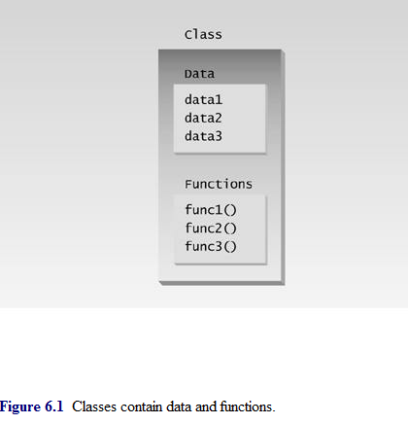
Placing data and functions together into a single entity is the central idea of object–oriented programming.

Slide 4
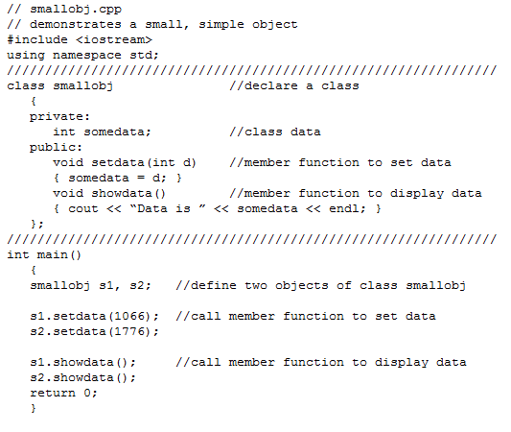

Slide 5
Our first program contains a class and two objects of that class.
Although it’s simple, the program demonstrates the syntax and general features of classes in C++.
The class smallobj declared in this program contains one data item and two member functions.
The two member functions provide the only access to the data item from outside the class.
The first member function sets the data item to a value, and the second displays the value.

Slide 6
Classes and Objects
an object has the same relationship to a class that a variable has to a data type. An object is said to be an instance of a class, in the same way someone 1954 Chevrolet is an instance of a vehicle.
In SMALLOBJ, the class—whose name is smallobj—is declared in the first part of the program. Later, in main(), we define two objects—s1 and s2—that are instances of that class.
Each of the two objects is given a value, and each displays its value. Here’s the output of the program:
Data is 1066 ← object s1 displayed this
Data is 1776 ← object s2 displayed this

Slide 7
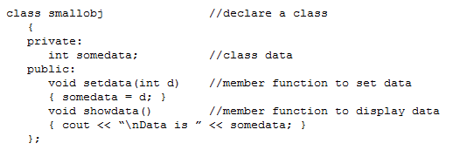
Declaring the Class
Here’s the declaration (sometimes called a specifier) for the class smallobj, copied from the SMALLOBJ listing:
The declaration starts with the keyword class, followed by the class name—smallobj in this example. Like a structure, the body of the class is delimited by braces and terminated by a semicolon. (Don’t forget the semicolon. Remember, data constructs like structures and classes end with a semicolon, while control constructs like functions and loops do not.)

Slide 8
private and public
The body of the class contains two unfamiliar keywords: private and public.
What is their purpose?
A key feature of object–oriented programming is data hiding.
The primary mechanism for hiding data is to put it in a class and make it private.
Private data or functions can only be accessed from within the class.
Public data or functions, on the other hand, are accessible from outside the class.

Slide 9
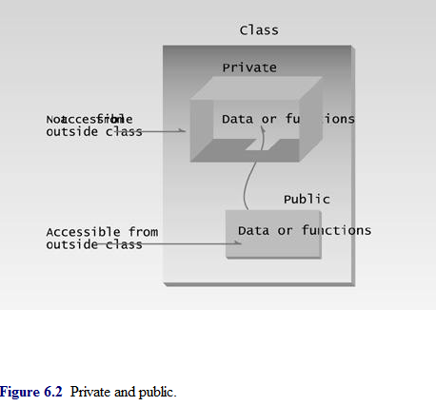

Slide 10
Class Data
The smallobj class contains one data item: somedata, which is of type int. The data items within a class are called data members (or sometimes member data). There can be any number of data members in a class, just as there can be any number of data items in a structure. The data member somedata follows the keyword private, so it can be accessed from within the class, but not from outside.
Member Functions
Member functions are functions that are included within a class. (In some object–oriented languages, such as Smalltalk, member functions are called methods; some writers use this term in C++ as well.) There are two member functions in smallobj: setdata() and showdata(). The function bodies of these functions have been written on the same line as the braces that delimit them. You could also use the more traditional format for these function definitions:
void setdata(int d)
{ somedata = d; }

Slide 11
Functions are Public, Data is Private
Usually the data within a class is private and the functions are public.
This is a result of how classes are used. The data is hidden so it will be safe from accidental manipulation, while the functions that operate on the data are public so they can be accessed from outside the class.
However, there is no rule that data must be private and functions public; in some circumstances you may find you’ll need to use private functions and public data.

Slide 12
Member Functions Within Class Declaration
The member functions in the smallobj class perform operations that are quite common in classes: setting and retrieving the data stored in the class.
The setdata() function accepts a value as a parameter and sets the somedata variable to this value.
The showdata() function displays the value stored in somedata.

Slide 13
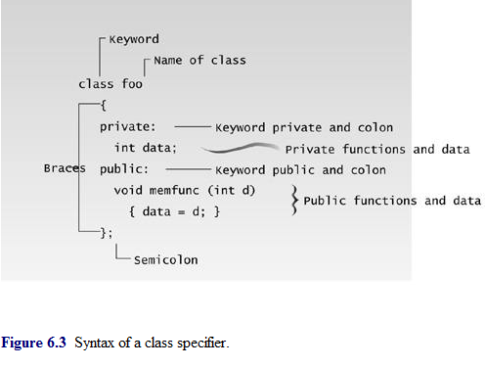
Using the Class
Now that the class is declared, let’s see how main() makes use of it. We’ll see how objects are defined, and, once defined, how their member functions are accessed.

Slide 14
Defining Objects
The first statement in main(),
smallobj s1, s2;
defines two objects, s1 and s2, of class smallobj. Remember that the declaration for the class smallobj does not create any objects. It only describes how they will look when they are created, just as a structure declaration describes how a structure will look but doesn’t create any structure variables.
It is the definition that actually creates objects that can be used by the program. Defining an object is similar to defining a variable of any data type: Space is set aside for it in memory.

Slide 15
Calling Member Functions
The next two statements in main() call the member function setdata():
s1.setdata(1066);
s2.setdata(1776);
These statements don’t look like normal function calls. Why are the object names s1 and s2 connected to the function names with a period? This strange syntax is used to call a member function that is associated with a specific object. Because setdata() is a member function of the smallobj class, it must always be called in connection with an object of this class. It doesn’t make sense to say
setdata(1066);
by itself, because a member function is always called to act on a specific object, not on the class in general

Slide 16
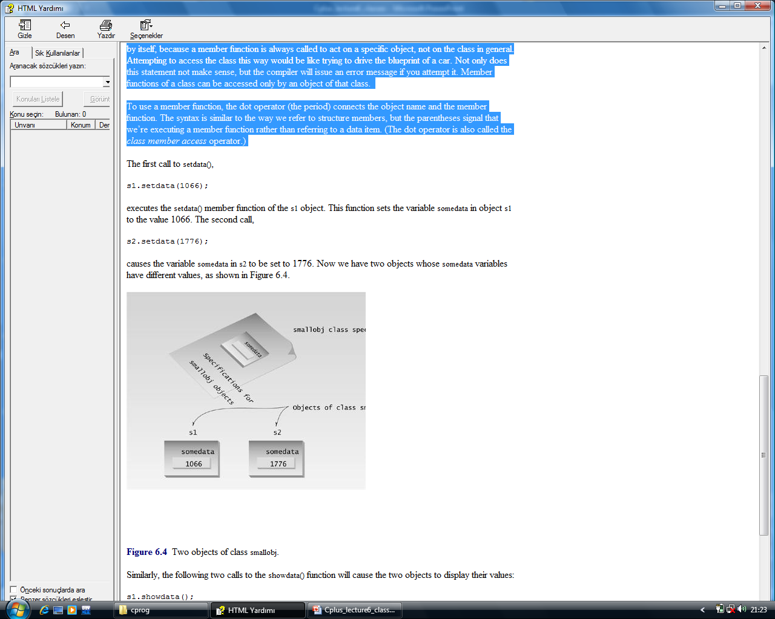

Slide 17
Messages
Some object–oriented languages refer to calls to member functions as messages. Thus the call
s1.showdata();
can be thought of as sending a message to s1 telling it to show its data.

Slide 18
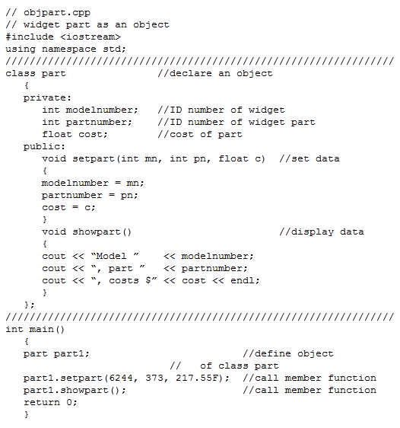

Slide 19
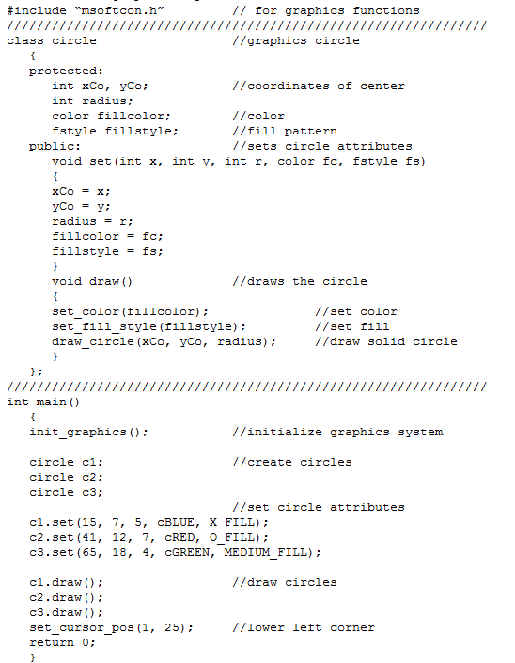

Slide 20
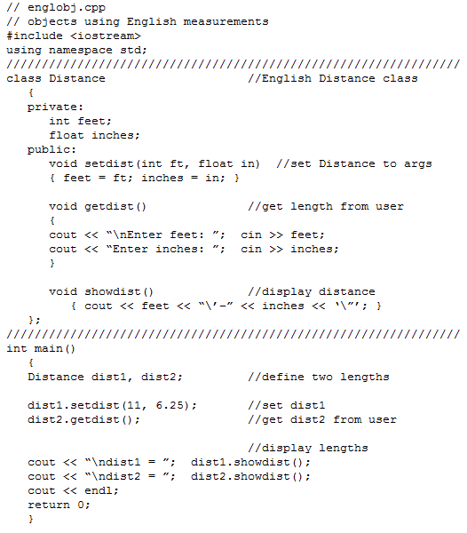

Slide 21
Constructors
The ENGLOBJ example shows two ways that member functions can be used to give values to the data items in an object. Sometimes, however, it’s convenient if an object can initialize itself when it’s first created, without the need to make a separate call to a member function.
Automatic initialization is carried out using a special member function called a constructor. A constructor is a member function that is executed automatically whenever an object is created.

Slide 22
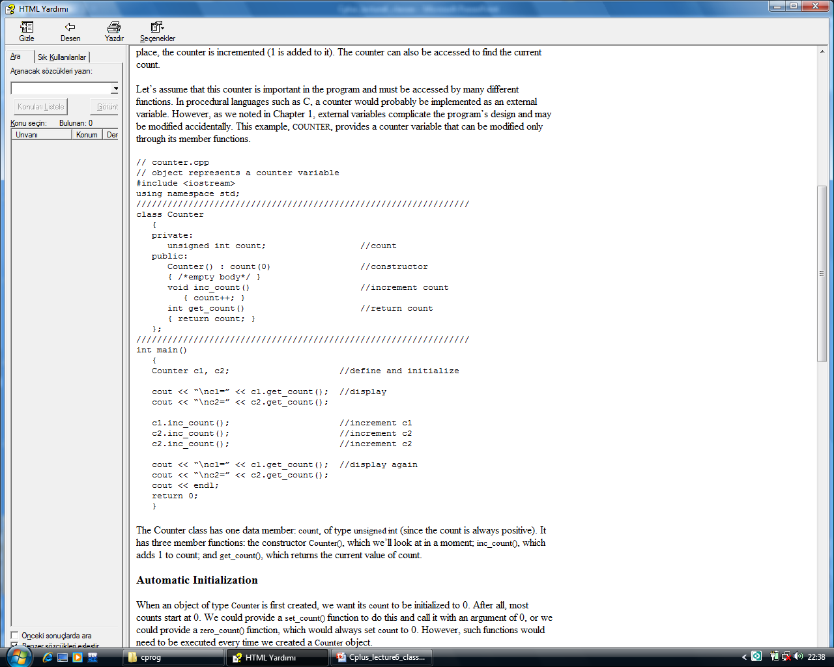

Slide 23
As an example, we’ll create a class of objects that might be useful as a general–purpose programming element. A counter is a variable that counts things. Maybe it counts file accesses, or the number of times the user presses the [Enter] key, or the number of customers entering a bank. Each time such an event takes place, the counter is incremented (1 is added to it). The counter can also be accessed to find the current count.
Let’s assume that this counter is important in the program and must be accessed by many different functions. In procedural languages such as C, a counter would probably be implemented as an external variable. However, as we noted in Chapter 1, external variables complicate the program’s design and may be modified accidentally. This example, COUNTER, provides a counter variable that can be modified only through its member functions.

Slide 24
The Counter class has one data member: count, of type unsigned int (since the count is always positive). It has three member functions: the constructor Counter(), which we’ll look at in a moment; inc_count(), which adds 1 to count; and get_count(), which returns the current value of count.

Slide 25
Automatic Initialization
When an object of type Counter is first created, we want its count to be initialized to 0. After all, most counts start at 0. We could provide a set_count() function to do this and call it with an argument of 0, or we could provide a zero_count() function, which would always set count to 0. However, such functions would need to be executed every time we created a Counter object.
Counter c1; //every time we do this,
c1.zero_count(); //we must do this too
This is mistake prone, because the programmer may forget to initialize the object after creating it. It’s more reliable and convenient, especially when there are a great many objects of a given class, to cause each object to initialize itself when it’s created.

Slide 26
In the Counter class, the constructor Counter() does this.
This function is called automatically whenever a new object of type Counter is created. Thus in main(), the statement
Counter c1, c2;
creates two objects of type Counter. As each is created, its constructor, Counter(), is executed. This function sets the count variable to 0. So the effect of this single statement is to not only create two objects, but also to initialize their count variables to 0.

Slide 27
Same Name As the Class
There are some unusual aspects of constructor functions.
First, it is no accident that they have exactly the same name (Counter in this example) as the class of which they are members.
This is one way the compiler knows they are constructors.
Second, no return type is used for constructors. Why not?
Since the constructor is called automatically by the system, there’s no program for it to return anything to; a return value wouldn’t make sense.
This is the second way the compiler knows they are constructors.

Slide 28
Initializer List
One of the most common tasks a constructor carries out is initializing data members. In the Counter class the constructor must initialize the count member to 0. You might think that this would be done in the constructor’s function body, like this:
count() { count = 0; }
However, this is not the preferred approach (although it does work).
count() : count(0) { }
The initialization takes place following the member function declarator but before the function body. It’s preceded by a colon. The value is placed in parentheses following the member data.
If multiple members must be initialized, they’re separated by commas. The result is the initializer list (sometimes called by other names, such as the member–initialization list).

Slide 29
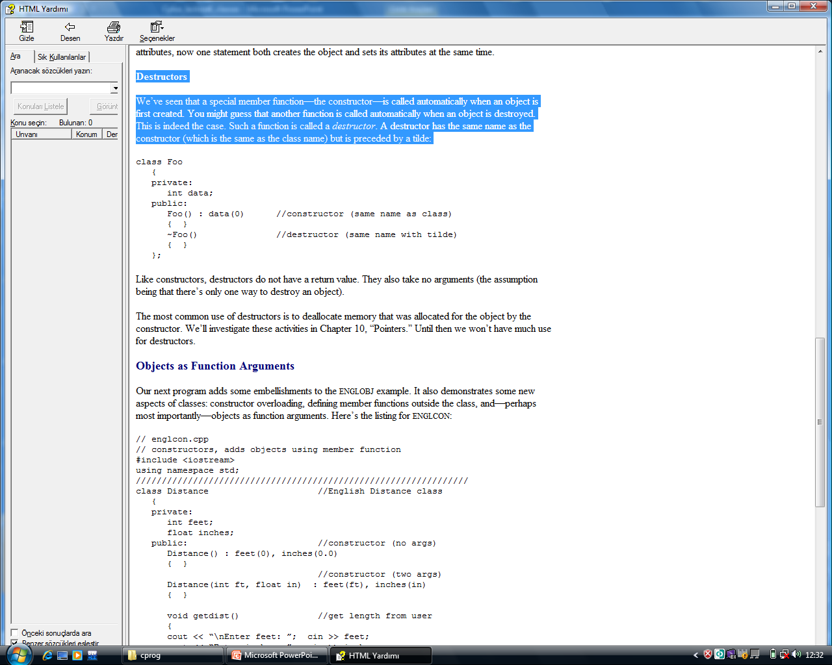
someClass() : m1(7), m2(33), m2(4) ← initializer list { }
Destructors
We’ve seen that a special member function—the constructor—is called automatically when an object is first created. You might guess that another function is called automatically when an object is destroyed. This is indeed the case. Such a function is called a destructor. A destructor has the same name as the constructor (which is the same as the class name) but is preceded by a tilde:
Like constructors, destructors do not have a return value. They also take no arguments (the assumption being that there’s only one way to destroy an object).

Slide 30
